Slide 1

Cascading Style Sheets (CSS)

Slide 2
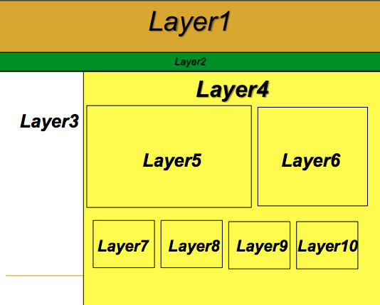
Introduction to CSS

Slide 3
Introduction to CSS
Content and formatting are 2 separate parts
The CSS concept separates content from presentation
Editing content becomes easy and formatting becomes much more consistent

Slide 4

Independent website with CSS stylesheet

Slide 5

Independent website without CSS stylesheet

Slide 6
<?xml version="1.0" encoding="iso-8859-1"?>
<!DOCTYPE html PUBLIC "-//W3C//DTD XHTML 1.1//EN"
"http://www.w3.org/TR/xhtml11/DTD/xhtml11.dtd">
<html xmlns="http://www.w3.org/1999/xhtml">
<head>
<title></title>
</head>
<body style="background-color: #FFFF99">
<center><img src="dit.gif" height="100" width="100"/></center>
<center><div style="position: absolute; top: 150px; width: 100%; height: 100px; background-color: blue;">
<h1><font color="white">DT228-1 2nd Semester Subjects</font></h1>
</div></center>
<center><div style="position:absolute; top:250px; width:100%; height:100px;"><ul>
<li> C Programming</li>
<li> Web Development</li>
</ul></div></center>
</body>
</html>
These are all style attributes

Slide 7
CSS Syntax
A rule is the fundamental syntactic unit of CSS
A CSS rule is a statement that follows a specific syntax

Slide 8
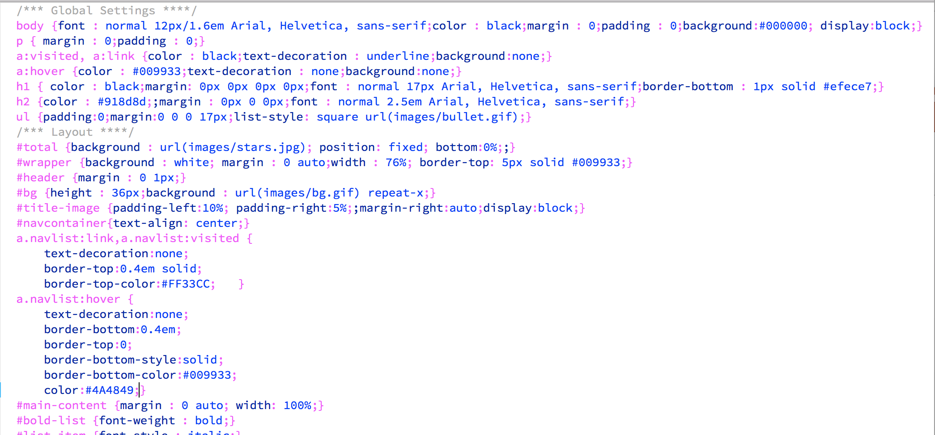
CSS Syntax
A CSS style sheet consists of a list of rules (statements)

Slide 9
CSS Selectors & Declarations
CSS style rule selector:
  HTML element name
  class
  Id

Slide 10
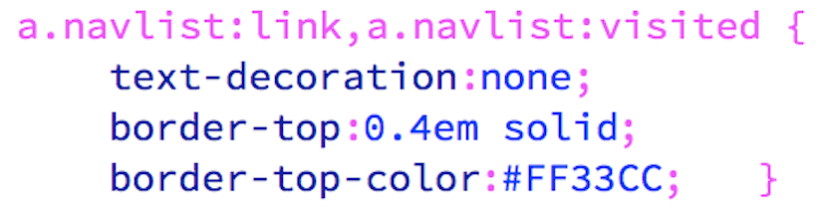
CSS Selectors & Declarations
CSS style rule selector:
  HTML element name
  Class
  id

Slide 11
CSS Selectors & Declarations
CSS style rule selector:
  HTML element name
  Class
  id

Slide 12
CSS Selectors & Declarations
CSS style rule selector:
  HTML element name
  class
  id
CSS style rule declaration:
  Indicates the CSS property that you are setting

Slide 13
CSS Selectors & Declarations
Declaration
Value
Selector
body {color: blue;}
Declaration
Property

Slide 14
Linking CSS to HTML5
Options for linking CSS to HTML:
  Inline CSS: Used to apply style to one HTML tag only using the style attribute inside the tag
  Embedded CSS: Used to apply style to an entire web page using the <style> tag inside the <head> tag
  External CSS: Used to apply style to an entire website by saving the CSS code in it own external file and using the <link> tag in the <head> section
  Import CSS: Works the same way as external CSS but uses the @import statement inside the <style> tag

Slide 15
CSS Option 1
Inline
  Affects individual HTML tag
  <html>
  ...
  <body>
  ...
  <p style=“font-family: Arial, sans- serif; ”>some text</p>
  </body>
  </html>

Slide 16
Inline CSS
index.html
services.html
contact.html
<html…>
<head>
….
</head>
<body>
Background is red
Font is blue
….
</body>
</html>
<html…>
<head>
….
</head>
<body>
Background is red
Font is blue
….
</body>
</html>
<html…>
<head>
….
</head>
<body>
Background is red
Font is blue
….
</body>
</html>

Slide 17
Inline CSS
Included (inline) in an HTML tag via the style attribute – in the body
<b style="color:blue; font-size:16;"> text goes here </b>

Slide 18
CSS Option 2
Embedded (in the head)
  Affects individual document
  <html>
  <head>
  ...
  <style>
  p {font-family: Arial, sans-serif;}
  </style>
  </head>
  <body>
  ...
  <p>some text</p>
  </body>
  </html>

Slide 19
Embedded CSS
index.html
services.html
contact.html
<html…>
<head>
Background is red
Font is blue
</head>
<body>
….
</body>
</html>
<html…>
<head>
Background is red
Font is blue
</head>
<body>
….
</body>
</html>
<html…>
<head>
Background is red
Font is blue
</head>
<body>
….
</body>
</html>

Slide 20
Embedded CSS
Included in the HTML code of a web page via the <style> tag
<head>
…
<style>
body {color: blue; background-color: #FFFF00;}
</style>
…
<head>

Slide 21
CSS Option 3
Separate text file (.css)
  e.g. styles.css
  p {
  font-family: Arial, Sans-serif;
  }
<html>
<head>
...
<link href=“styles.css”
rel=“stylesheet” type=“text/css” />
</head>
<body>
...
<p>some text</p>
</body>
</html>

Slide 22
External CSS
style.css
Background is red
Font is blue
ONLY ONE STYLESHEET!!!
index.html
services.html
contact.html
<html…>
<head>
<link ….>
</head>
<body>
….
</body>
</html>
<html…>
<head>
<link ….>
</head>
<body>
….
</body>
</html>
<html…>
<head>
<link ….>
</head>
<body>
….
</body>
</html>

Slide 23
External CSS
CSS code is stored in its own file that the HTML code of any web page can reference and use
<head>
….
<link rel="stylesheet” href="cssFile.css”>
….
</head>

Slide 24
CSS Option 4
Imported
Into HTML file
<head>
...
<style>
@import url(“styles.css”);
</style>
</head>
Into another style sheet
- @import instruction must be first
line of file!
@import url(“styles.css”);
/*other stylesheet starts here*/
h1 {
font-size: 200%;
color: #6b84b5
}

Slide 25
Import CSS
A style sheet may be imported with the at-rule - @import
<head>
…..
<style type="text/css">
@import url("myStyle.css");
@import url("http://www.aa.bb.cc/dd.css");
body {color: blue; background: yellow}
</style>
….
</head>

Slide 26
Order of Precedence
HTML formatting instructions (e.g. <font> tags)
Inline styles
Embedded styles
Linked styles
Imported styles
Default browser styles
More powerful

Slide 27
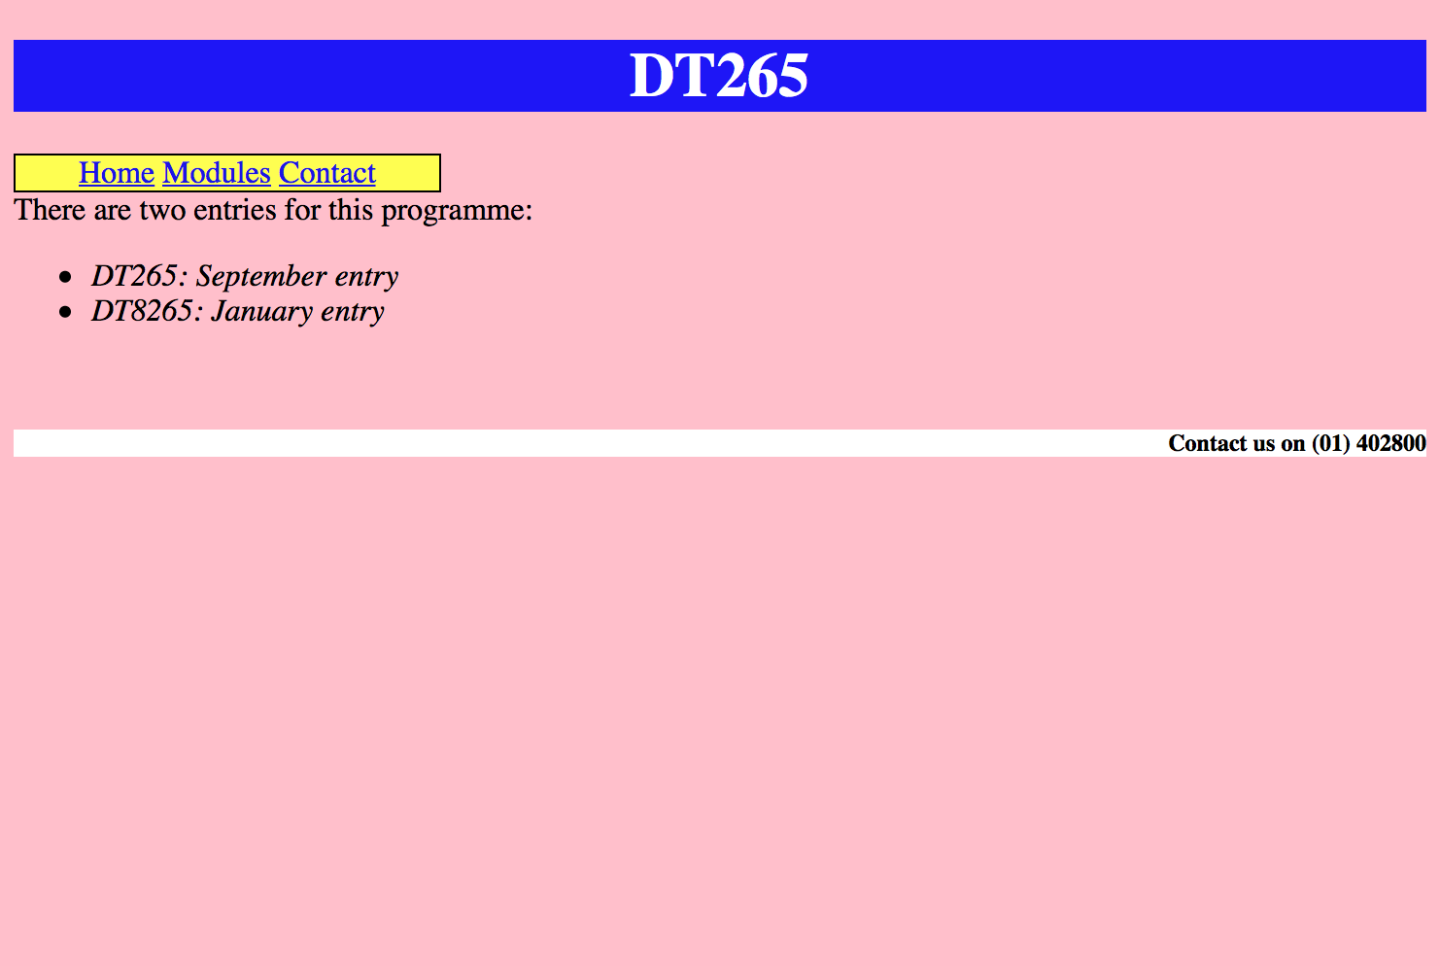
Code this web page using inline and embedded CSS

Slide 28
Now, we want to use an external stylesheet..
Look at the short video on Brightspace – “Connecting a CSS Stylesheet”.
If the style sheet is not working, check the following:
  Are all files in the same folder – both html and css files
  In the <link> tag, is the name of the .css file spelt correctly (capital letters are taken into consideration)
  Is the syntax of the css rule correct? :, ;, {}

Slide 29
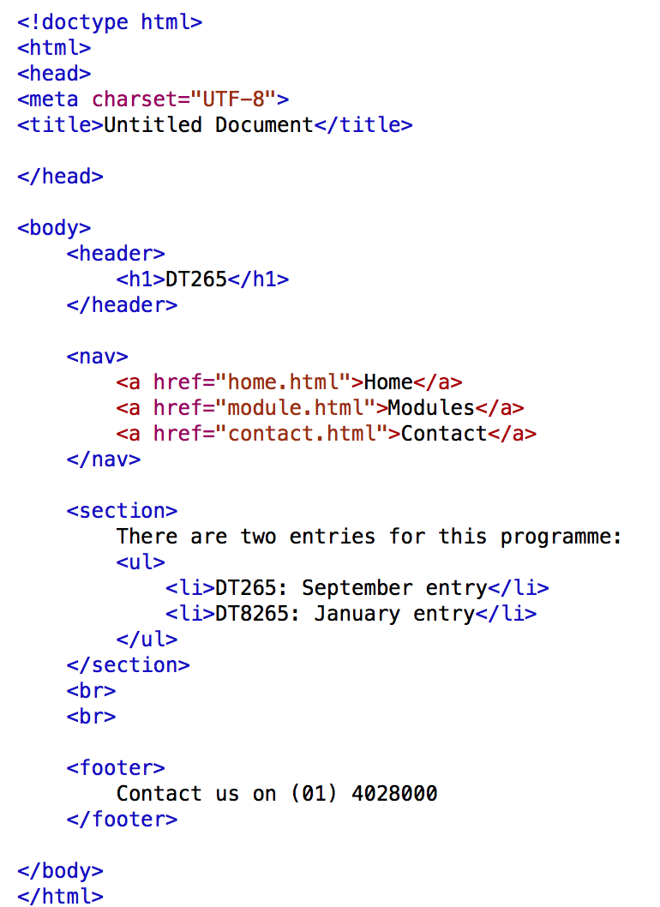
Now use an external stylesheet to style this page

Slide 30
Classes & IDs

Slide 31
Types of CSS styles
Styles assigned to a HTML element
Class selector styles
  Define different styles for one or more HTML elements
  Assigned to the class attribute within an HTML element
ID selector styles
  Define different styles for one and the same HTML element
  Assigned to the ID attribute within an HTML element

Slide 32
Class Selector Styles
CSS:
  …
  .blue {color: #082984}
  .red {color: #de2131}
HTML:
  …
  <h1 class=“red”>Headline</h1>
  <p class=“red”>a summary</p>
  <p class=“blue”>some text</p>
  …

Slide 33
ID Selector styles
CSS
…
#red_heading {color: red}
#summary {color: red}
p#conclusion {color: blue}
HTML
…
<h1 id=“red_heading”>Headline</h1>
<p id=“summary”>Summary</p>
<p id=“conclusion”>Conclusion</p>
…

Slide 34
What is the Difference between class & id?
The difference between an ID and a class is that an ID can be used to identify one element, whereas a class can be used to identify more than one.
If you have a style that you want to apply several times throughout the document, you need to use a Class. However, it if only want to apply the style once (for instance, to position a particular element, such as a banner) you should use the ID.

Slide 35
Introduce classes or ids to the DT265 website….

Slide 36
Reference
Terry Felke-Morris (2013), Web Development and Design Foundations with HTML
Ibrahim Zeid (2004), Mastering the Internet, XHTML, and Javascript

